Slide 1
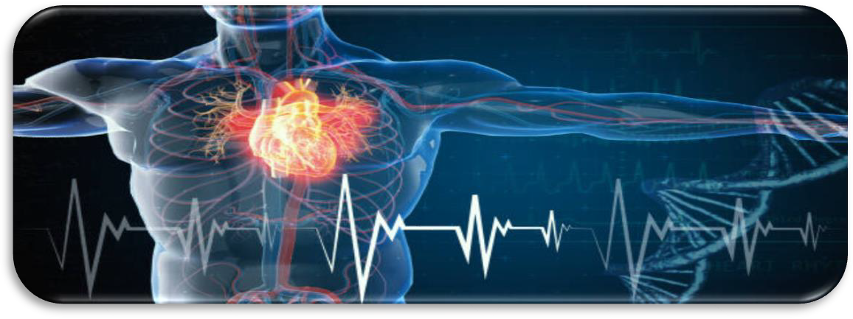
Cardiovascular Risk Prediction Predictive Analytics with Case Studies(CSE3085)
NOEL BENNY - 20MIA1020
ANTONY GEORGE MATHEW – 20MIA1022
DIYA AL DIN – 20MIA1048 HIDESH MATHEW SEBI - 20MIA1064

Slide 2
Problem Statement:
The dataset is from an ongoing cardiovascular study on residents of the town of Framingham, Massachusetts.
The classification goal is to predict whether the patient has a 10-year risk of future coronary heart disease(CHD).
The dataset provides the patients’ information. It includes over 4,000 records and 15 attributes. Variable Each attribute is a potential risk factor. There are both demographic, behavioral, and medical risk factors.

Slide 3
Data description:
Demographic:
Sex: male or female("M" or "F")
Age: Age of the patient;(Continuous - Although the recorded ages have been truncated to whole numbers, the concept of age is continuous)
Behavioral
is_smoking: whether or not the patient is a current smoker ("YES" or "NO")
Cigs Per Day: the number of cigarettes that the person smoked on average in one day.(can be considered continuous as one can have any number of cigarettes, even half a cigarette.)
Medical( history)
BP Meds: whether or not the patient was on blood pressure medication (Nominal)
Prevalent Stroke: whether or not the patient had previously had a stroke (Nominal)
Prevalent Hyp: whether or not the patient was hypertensive (Nominal)
Diabetes: whether or not the patient had diabetes (Nominal) Medical(current)
Tot Chol: total cholesterol level (Continuous)
Sys BP: systolic blood pressure (Continuous)
Dia BP: diastolic blood pressure (Continuous)
BMI: Body Mass Index (Continuous)
Heart Rate: heart rate (Continuous - In medical research, variables such as heart rate though in fact discrete, yet are considered continuous because of large number of possible values.)
Glucose: glucose level (Continuous) Predict variable (desired target)

Slide 4
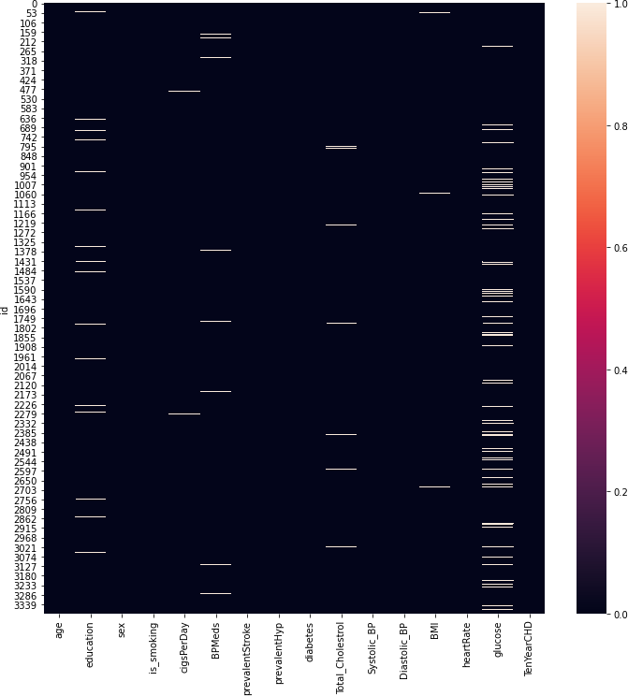
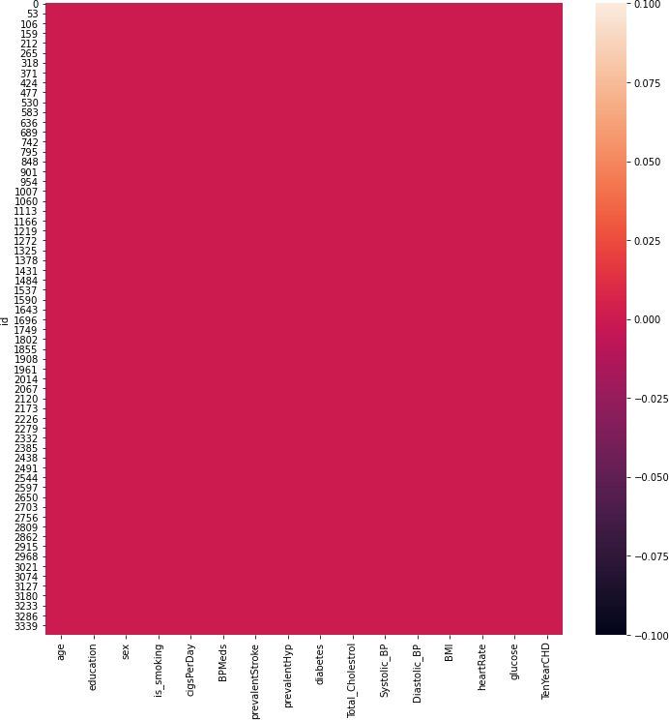
Missing Values & After filling NaN Values

Slide 5
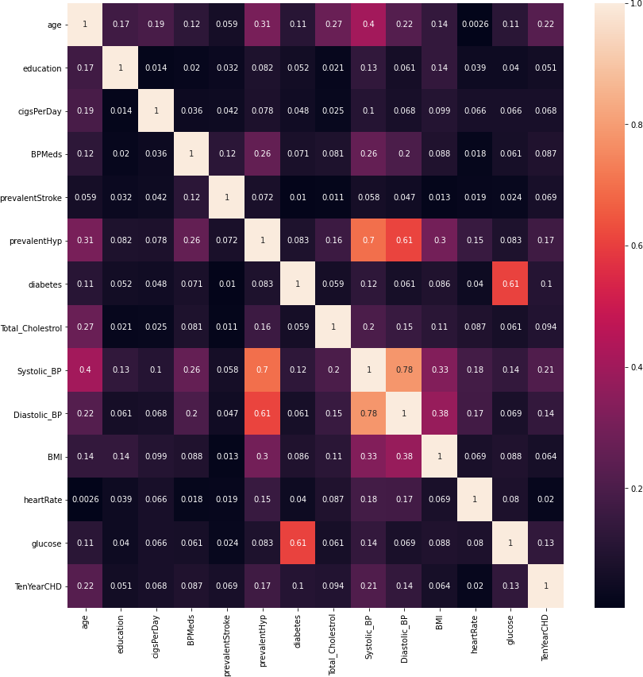
Correlation between features

Slide 6
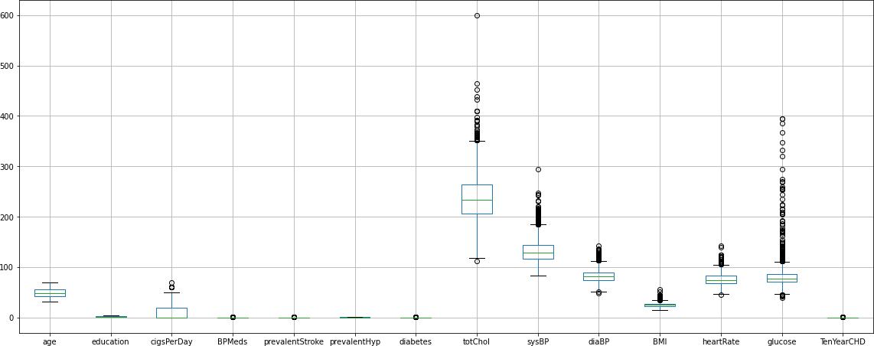
Outlier detection

Slide 7
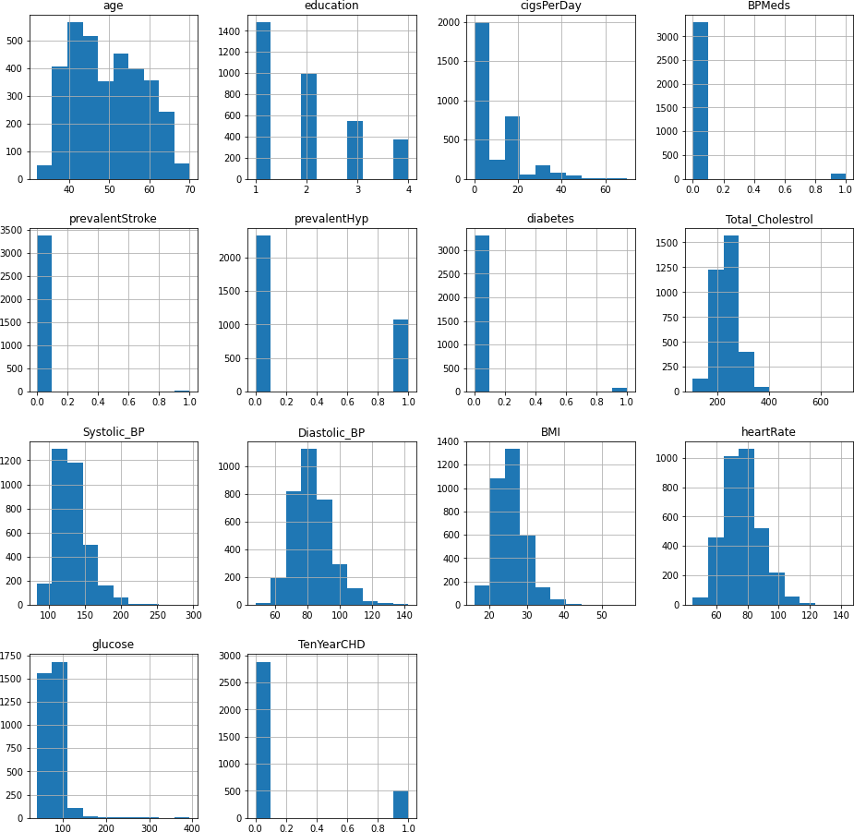
Distribution of data

Slide 8
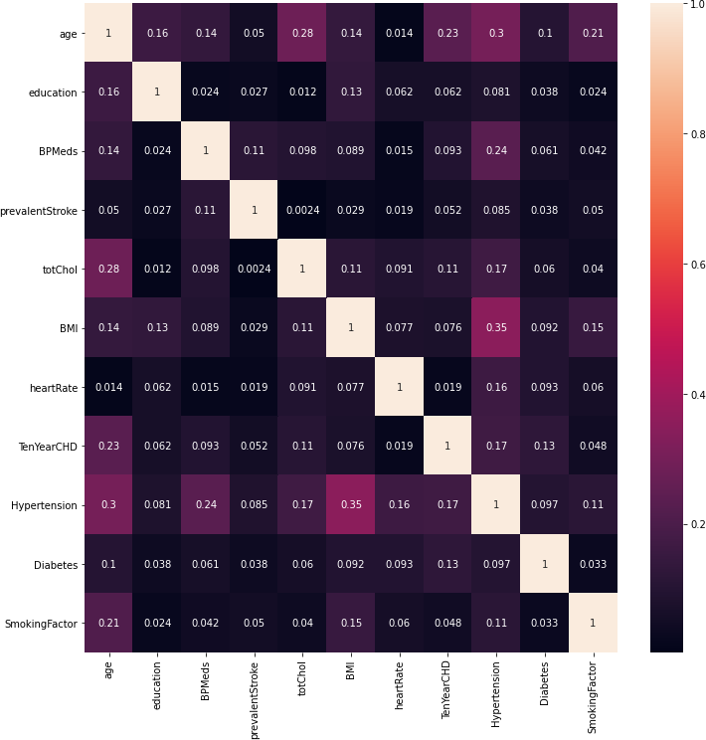
Correlation between features after feature engineering

Slide 9
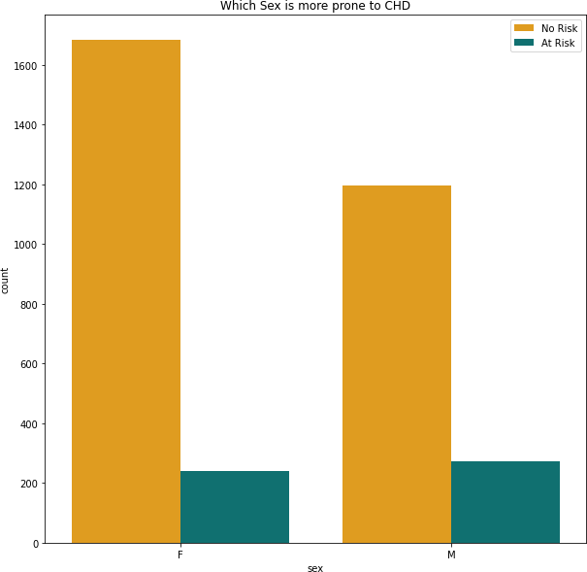
Which Sex is more prone to CHD ?

Slide 10
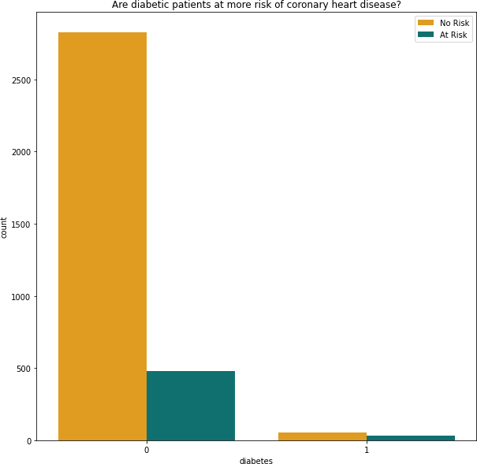
Are diabetic patients at more risk of chd ?

Slide 11
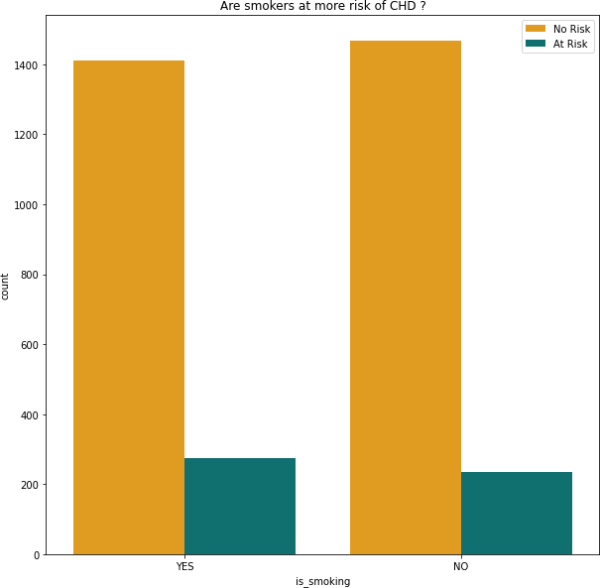
Are smokers at more risk of chd ?

Slide 12
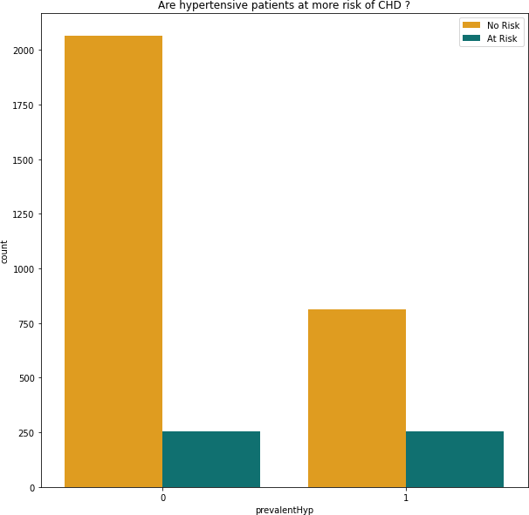
Are hypertensive patients at more risk of chd ?

Slide 13
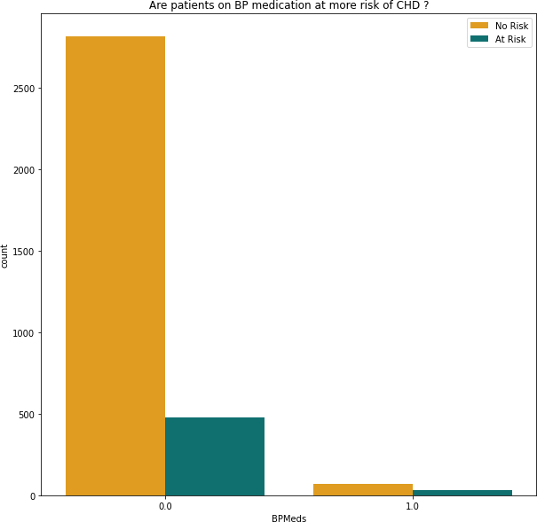
Are patients on bp medication at more risk of chd ?

Slide 14
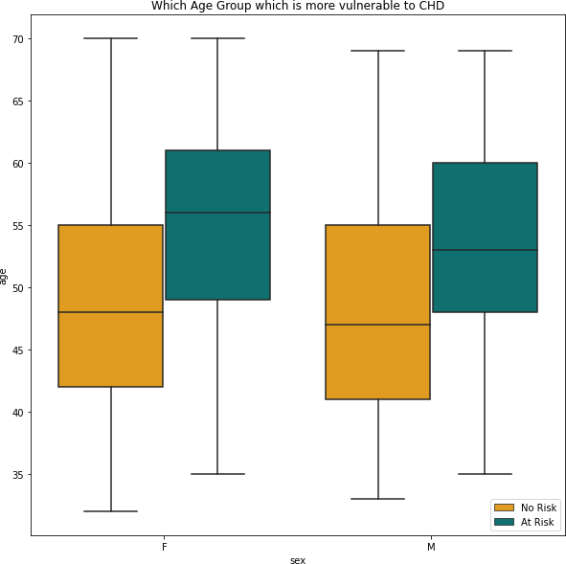
Which age group is more vulnerable to chd ?

Slide 15
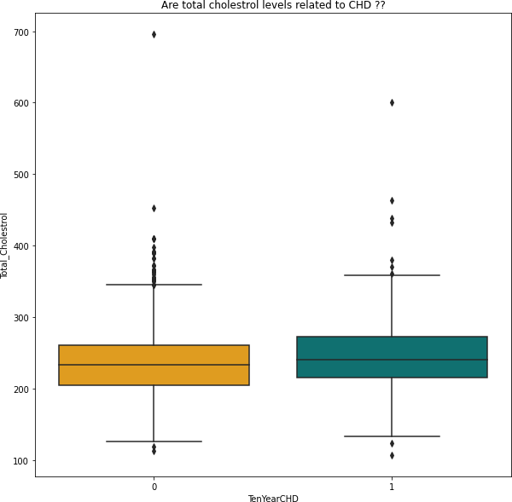
Are total cholesterol levels related to chd ?
This indicates that cholestrol level is not the sole deciding factor for predicting whether the person gets coron ary heart disease or not.
People with similar levels of cholestrol have got coronary heart disease as well as are free from coronary hea rt disease.
Clearly, there is no direct correlation of coronary heart disease with the cholestrol level.

Slide 16
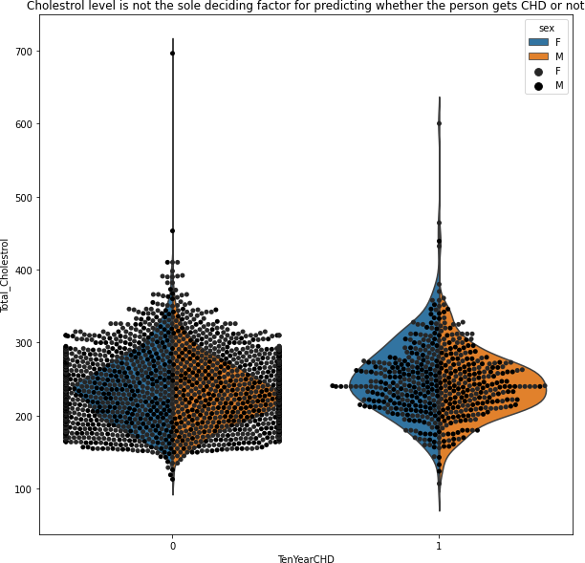
Cholestrol level is not the sole deciding factor for chd

Slide 17
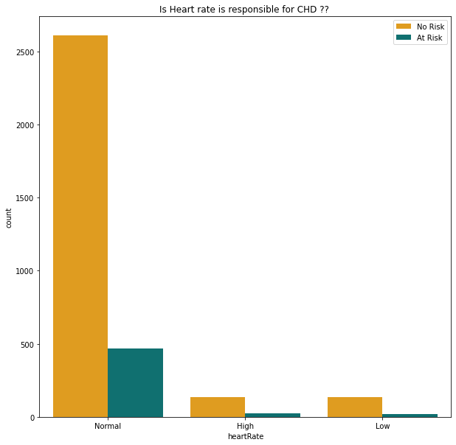
Can Heart rate possibly define the risk of chd ?

Slide 18
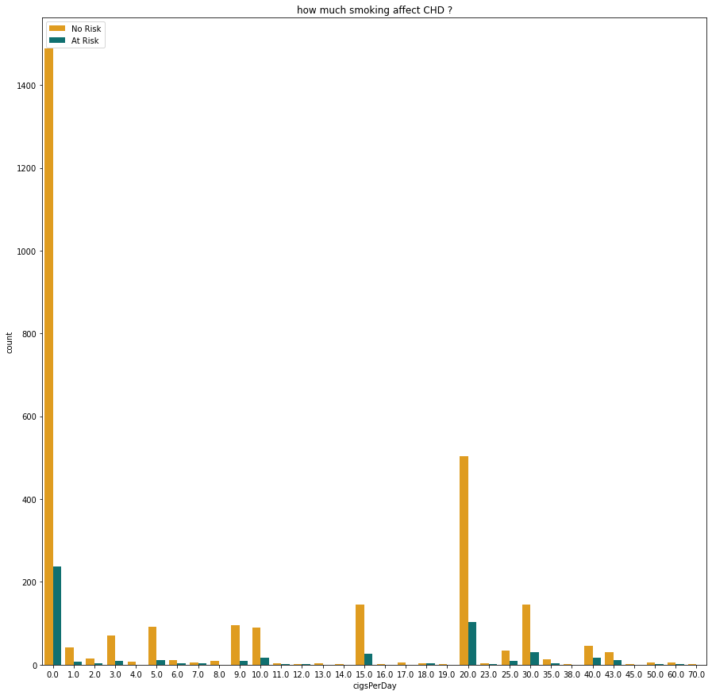
Can smoking number of cigarettes per day lead to chd?

Slide 19
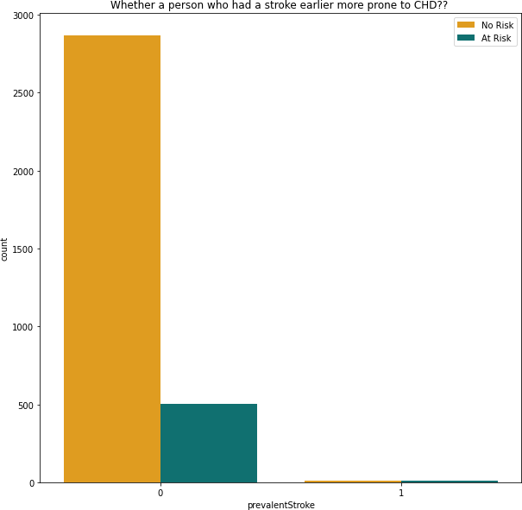
One who had a stroke earlier more prone to chd ?

Slide 20
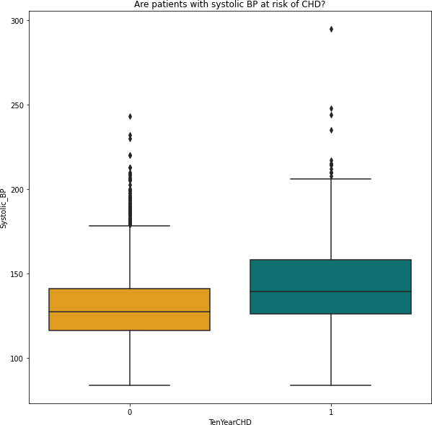
Are patients with systolic bp at risk of chd ?

Slide 21
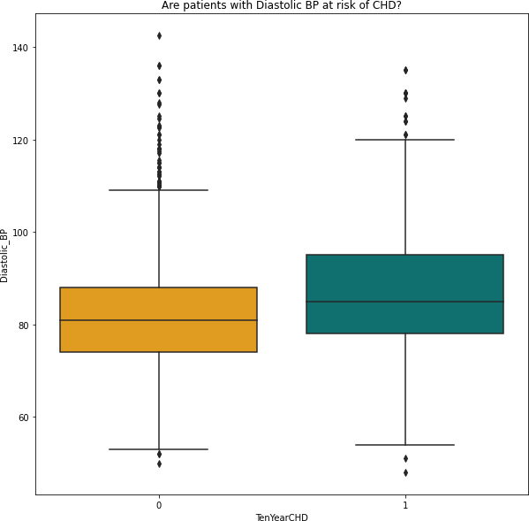
Are patients with diastolic bp at risk of chd ?

Slide 22
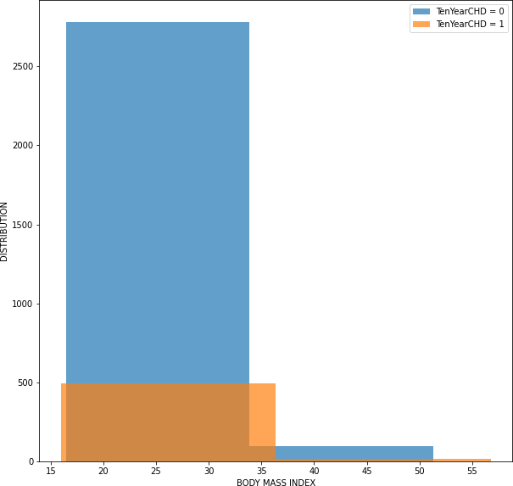
is patients bmi important to show the risk of chd ?

Slide 23
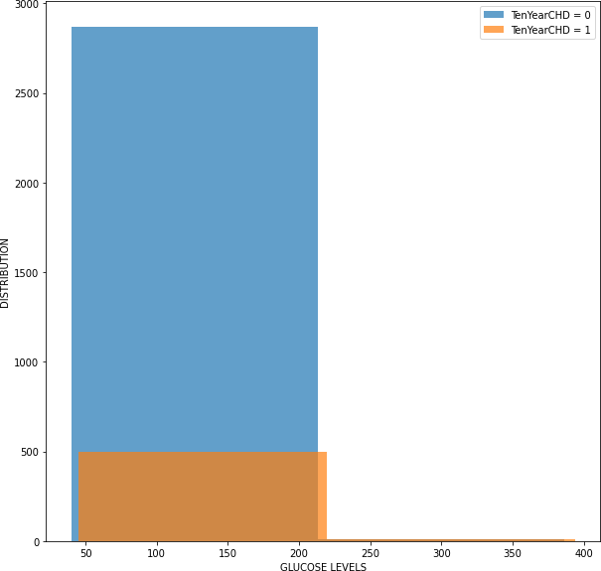
Can patients glucose levels show the risk of chd ?

Slide 24
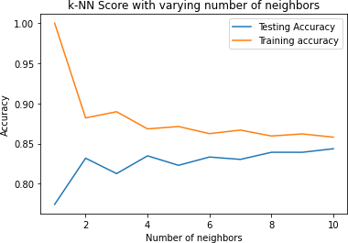
K-nn score with varying number of neighbors

Slide 25
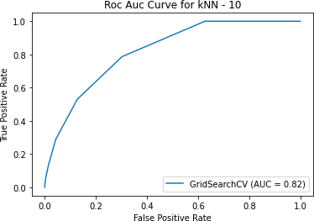
Roc auc curve for knn

Slide 26
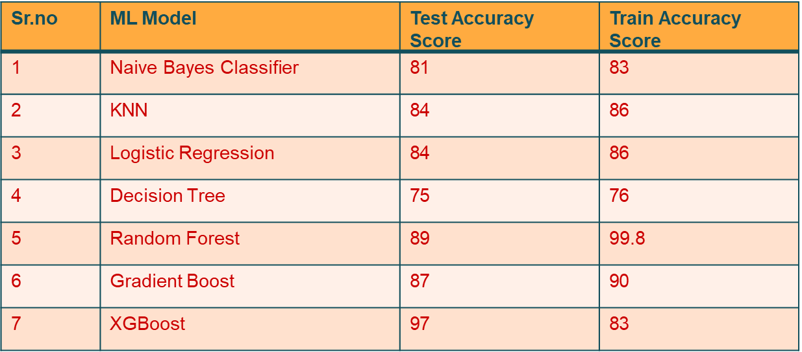
The best fitting Model:-

Slide 27
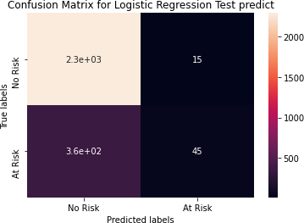
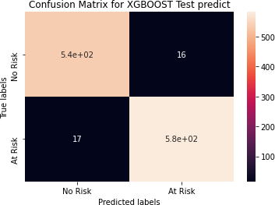
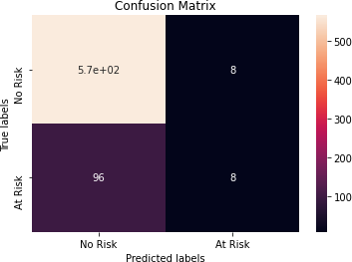
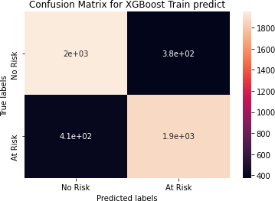
Confusion Matrix

Slide 28
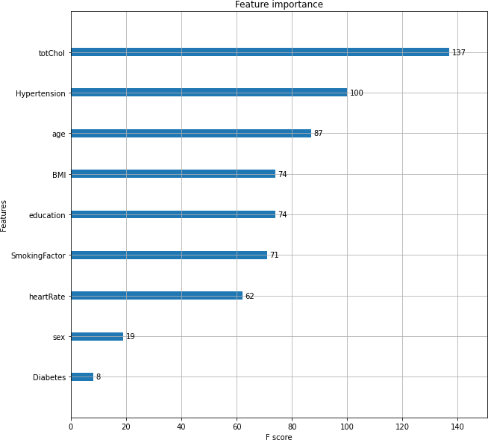
The Feature Importance

Slide 29
Precision and Recall:-
The precision is the proportion of relevant results in the list of
all returned search results.
The recall is the ratio of the relevant results returned by the search engine to the total number of the relevant results that could have been returned.
In this project we are giving more importance to recall because predicting that the person doesn’t have a disease when he have one can risk that persons life.

Slide 30
challenges:
Less amount of data available made it difficult to predict properly.
Missing relevant/Important features in our dataset like Chest pain location, chest pain type, Family history of coronary artery, Exercise, etc.
The dataset was imbalanced and hence we were not able to apply
some models properly.

Slide 31
Conclusion:
A cardiovascular disease detection model has been built using no of ML
classification modelling techniques.
This project once deployed can possibly help predict the patients for cardiovascular disease based to their past medical history Blood pressure, Body mass index, Sugar levels etc.
The algorithms used in building the model are Logistic regression, Decision trees, KNN, Random forest classifier, Naive bayes classifier, Gradient boost and XGboost.
The top three models with best accuracy are Gradient boost, Random forest & XGboost with accuracy of 87%, 89%,and 97% respectively.

